Slide 1
Lesson 4

Slide 2
Deploying your page to the server (1)
Go to your AWS Lightsail console https://lightsail.aws.amazon.com/ls/webapp/home/instances
Copy paste your IP address in the browser and access it
Open a web SSH terminal
Navigate: cd htdocs
Create a file called one.html and put some conent. Use VIM editor as follows:
vim one.html
Once it opens to start writing first hit i
Write your HTML
Once done, hit ESC key then type wq and enter
Access the file by going to <yourIP>/one.html

Slide 3
Console and File Transfer Protocols
TRANSFER PROTOCOLS
FTP – File Transfer Protocol - standard network protocol used for the transfer of computer files between a client and server on a computer network (Wikipedia).
SSH - secure remote login from one computer to another
SCP – SSH copy
SFTP – FTP over secure connection (Secure FTP)
Clients: Putty(ssh), FileZilla(ftp/sftp), WinSCP (scp), OpenSSH

Slide 4
Deploying your page to the server (2)
Now do the same using your own ssh client (git bash, putty). See “Connect using your own SSH client” instructions on Lightsail and follow these: https://docs.bitnami.com/aws/faq/get-started/connect-ssh/ https://protechgurus.com/connect-ec2-linux-instance-using-putty-gitbash-web-browser/
Download your .pem key
eval `ssh-agent -s`- start ssh agent to add the key
ssh-add LightsailDefaultKey-us-east-1.pem – to add your private key to ssh agent
Run something like: ssh bitnami@18.100.100.100
ls –al or pwd to see your current folder content/location exit to leave the connection
SCP a file to your server
cd ~/Desktop/Grandview/GrandviewClass2019/Lesson4
scp sourceFile user@host:destFile
Homework: Connect with WinSCP to be able to upload files from local to your server (or any sftp)
Connect with WinSCP - find the file “Installing WINSCP to connect to Amazon Lightsail server.pdf” on Blackboard in week’s folder for instruction

Slide 5
PHP Gentle Introduction - Form Validation (didn’t get the chance to go through)
<?php ... ?>
echo “something to display”;
$_GET(“name”) or $_POST(“name”)
Now let’s deploy your form to the server and check Name has been entered! The result should be something like this:
Cache troubleshooting:
https://docs.bitnami.com/oci/infrastructure/lamp/administration/disable-cache/ and reboot.

Slide 6
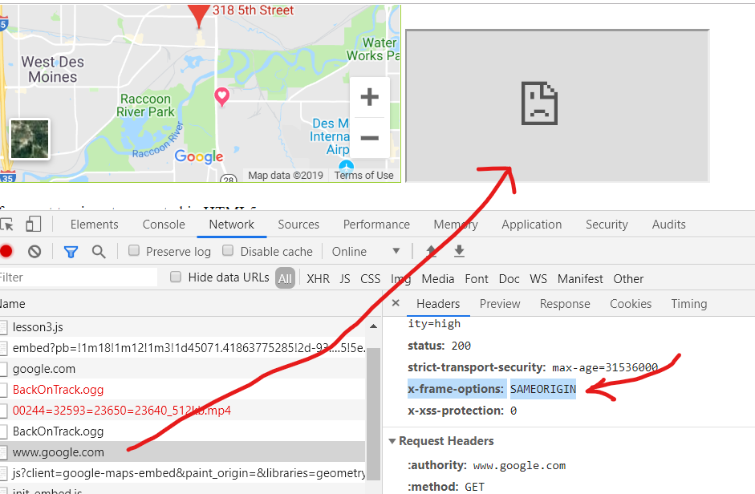
HTML
origin policy
X-frame-options
Security: Cross site request forgery

Slide 7
HTML Image tag
HTML <img> Tag
<img src=“img1.gif" alt=“Sunshine" height="42" width="42">
The <img> tag defines an image in an HTML page.
The <img> tag has two required attributes: src and alt.
Read more at:https://www.w3schools.com/tags/tag_img.asp
Image maps:

Slide 8
HTML Form in depth
<form action="/action_page.php" method="get"> First name: <input type="text" name="fname"><br> Last name: <input type="text" name="lname"><br> <input type="submit" value="Submit"> </form>
Methods can be GET or POST, difference?
Encryption types:
enctype="multipart/form-data“
enctype=“application/x-www-form-urlencoded” (default)
enctype=“ text/plain” – only spaces are converted to "+" symbols

Slide 9
HTML Input and single tags
https://www.w3schools.com/tags/tag_input.asp
<tag>…</tag> - this is a “paired” tag
<br/> <img/> <hr/> - these are “single” tags
Notice the location of / sign.

Slide 10
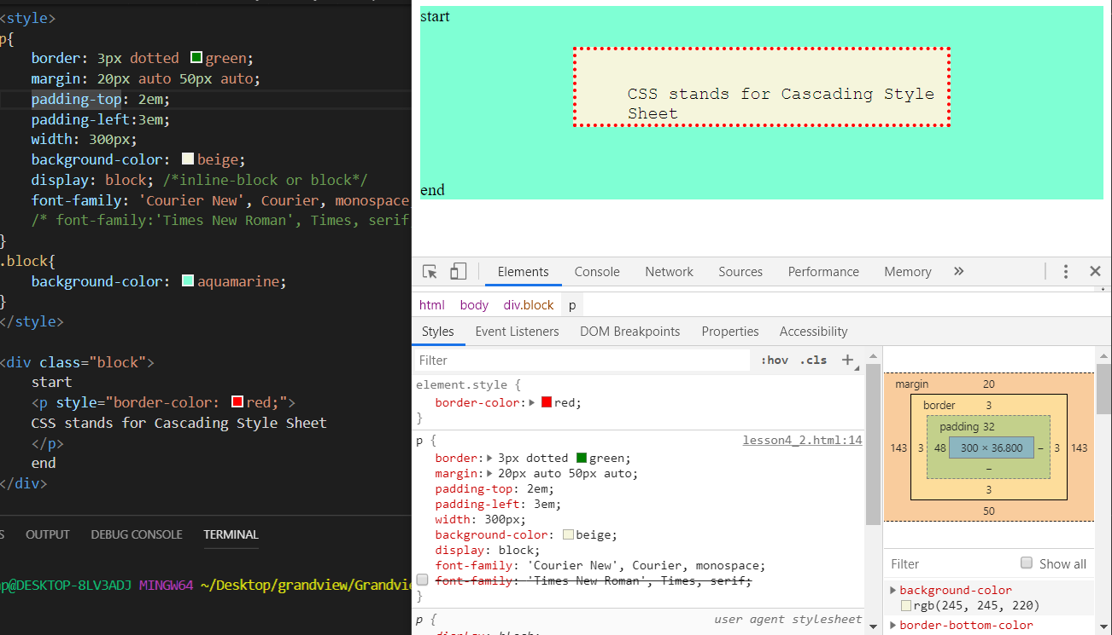
CSS Example

Slide 11
CSS Continuation
Specificity – tag – class – id – will tell which style to apply when conflicts occur
!important will override specificity
CSS – Cascade style sheet – the styles cascade, i.e. styles cascades/are added from the top of the stylesheet to the other.
Stylesheets lower in html have higher priority (override styles before them)
Inline CSS has higher priority than in file.
Element style has higher priority then all of the above.
Example below. More information (besides w3school): https://learn.shayhowe.com/html-css/getting-to-know-css/

Slide 12
CSS tips and recipes
Positioning: absolute, fixed, relative
Margin: auto, em, px, %; top right bottom left (margin: 10px 5px 15px 20px)
Padding – space between content and border

Slide 13
Readings and Practice (1)
https://www.webdesignerdepot.com/2016/10/20-essential-css-tricks-every-designer-should-know/
Getting to Know CSS : https://learn.shayhowe.com/html-css/getting-to-know-css/ (required reading on CSS, it describe in simple terms)
https://www.webdesignerdepot.com/2016/10/20-essential-css-tricks-every-designer-should-know/
W3school – practice CSS (following slides has the elements on which to focus)
Recommended: listen to Level Up With CSS - Part 1 and Level Up With CSS - Part 2 on https://ladybug.dev/ or wherever you get your podcasts. It’s a great CSS discussion from a practitioner and teacher.

Slide 14
Readings and Practice (2)
Go to CSS Tutorial and practice the following:
 | CSS Fonts CSS Layout - The display Property CSS Layout - The position Property CSS Layout - inline-block CSS Pseudo-classes CSS Pseudo-elements CSS Styling Lists CSS Styling Tables CSS Layout - width and max-width
Assignment: Create your own 2 page CSS cheat-sheet with examples of usage and public it on your GitHub project.
We will have a quiz on Thursday. You will be allowed to only use your cheat-sheet.
(I do use things like that when I work on real projects, so why not. What matters is that you learn how to take bits of information and build something with it )

Slide 16
Homework and Project Discussion

